Slide 1

Automatic Detection of Parkinson’s Disease
Using Gait Signals and State Space Models/Mamba
Task 1: Baseline Data Analysis & TSFresh Feature Exploration
Saranya Bhattacharjee (aj81owid)
MSc Artificial Intelligence
Project Time Series, Pattern Recognition Lab
Supervisor: Dr.-Ing. Tomás Arias-Vergara
Date: 07 November 2025

Slide 2
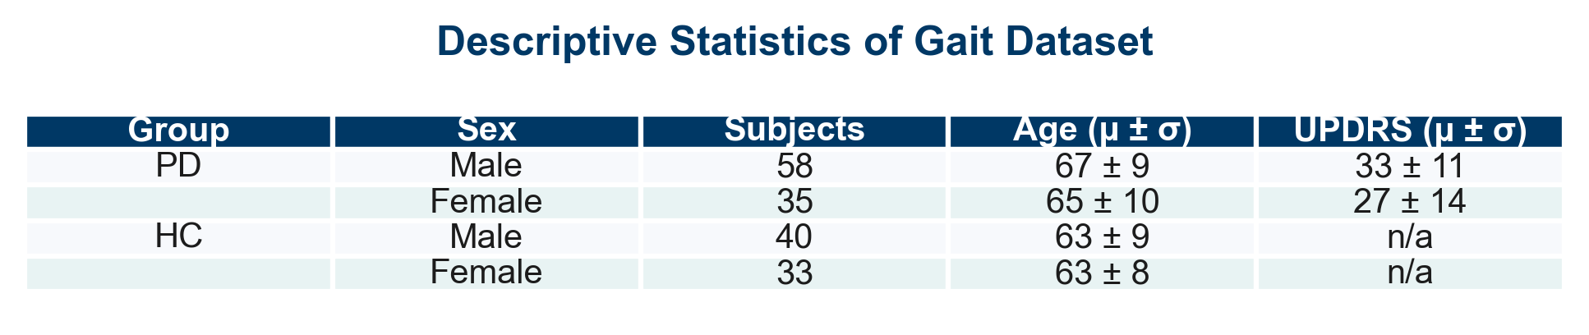
Dataset Overview: PhysioNet
Gait in Parkinson’s Disease Database (166 subjects — 93 PD, 73 healthy controls)
Contains vertical ground reaction force (vGRF) signals from 8 sensors per foot (16 total channels).
Recording duration: ~2 minutes of natural walking on an 8-force-plate walkway.
Sampling frequency: 100 Hz (≈ 12 000 samples per foot, ≈ 24 000 total per subject).
Clinical evaluation: Unified Parkinson’s Disease Rating Scale (UPDRS) for PD subjects.
Higher UPDRS scores indicate greater motor symptom severity.
Aim (for this task):
To explore baseline gait signal characteristics and extract TSFresh-based features for future State Space Model (SSM) analysis.
Only usual-walking trials (‘01’) were used to ensure consistent gait conditions.

Slide 3
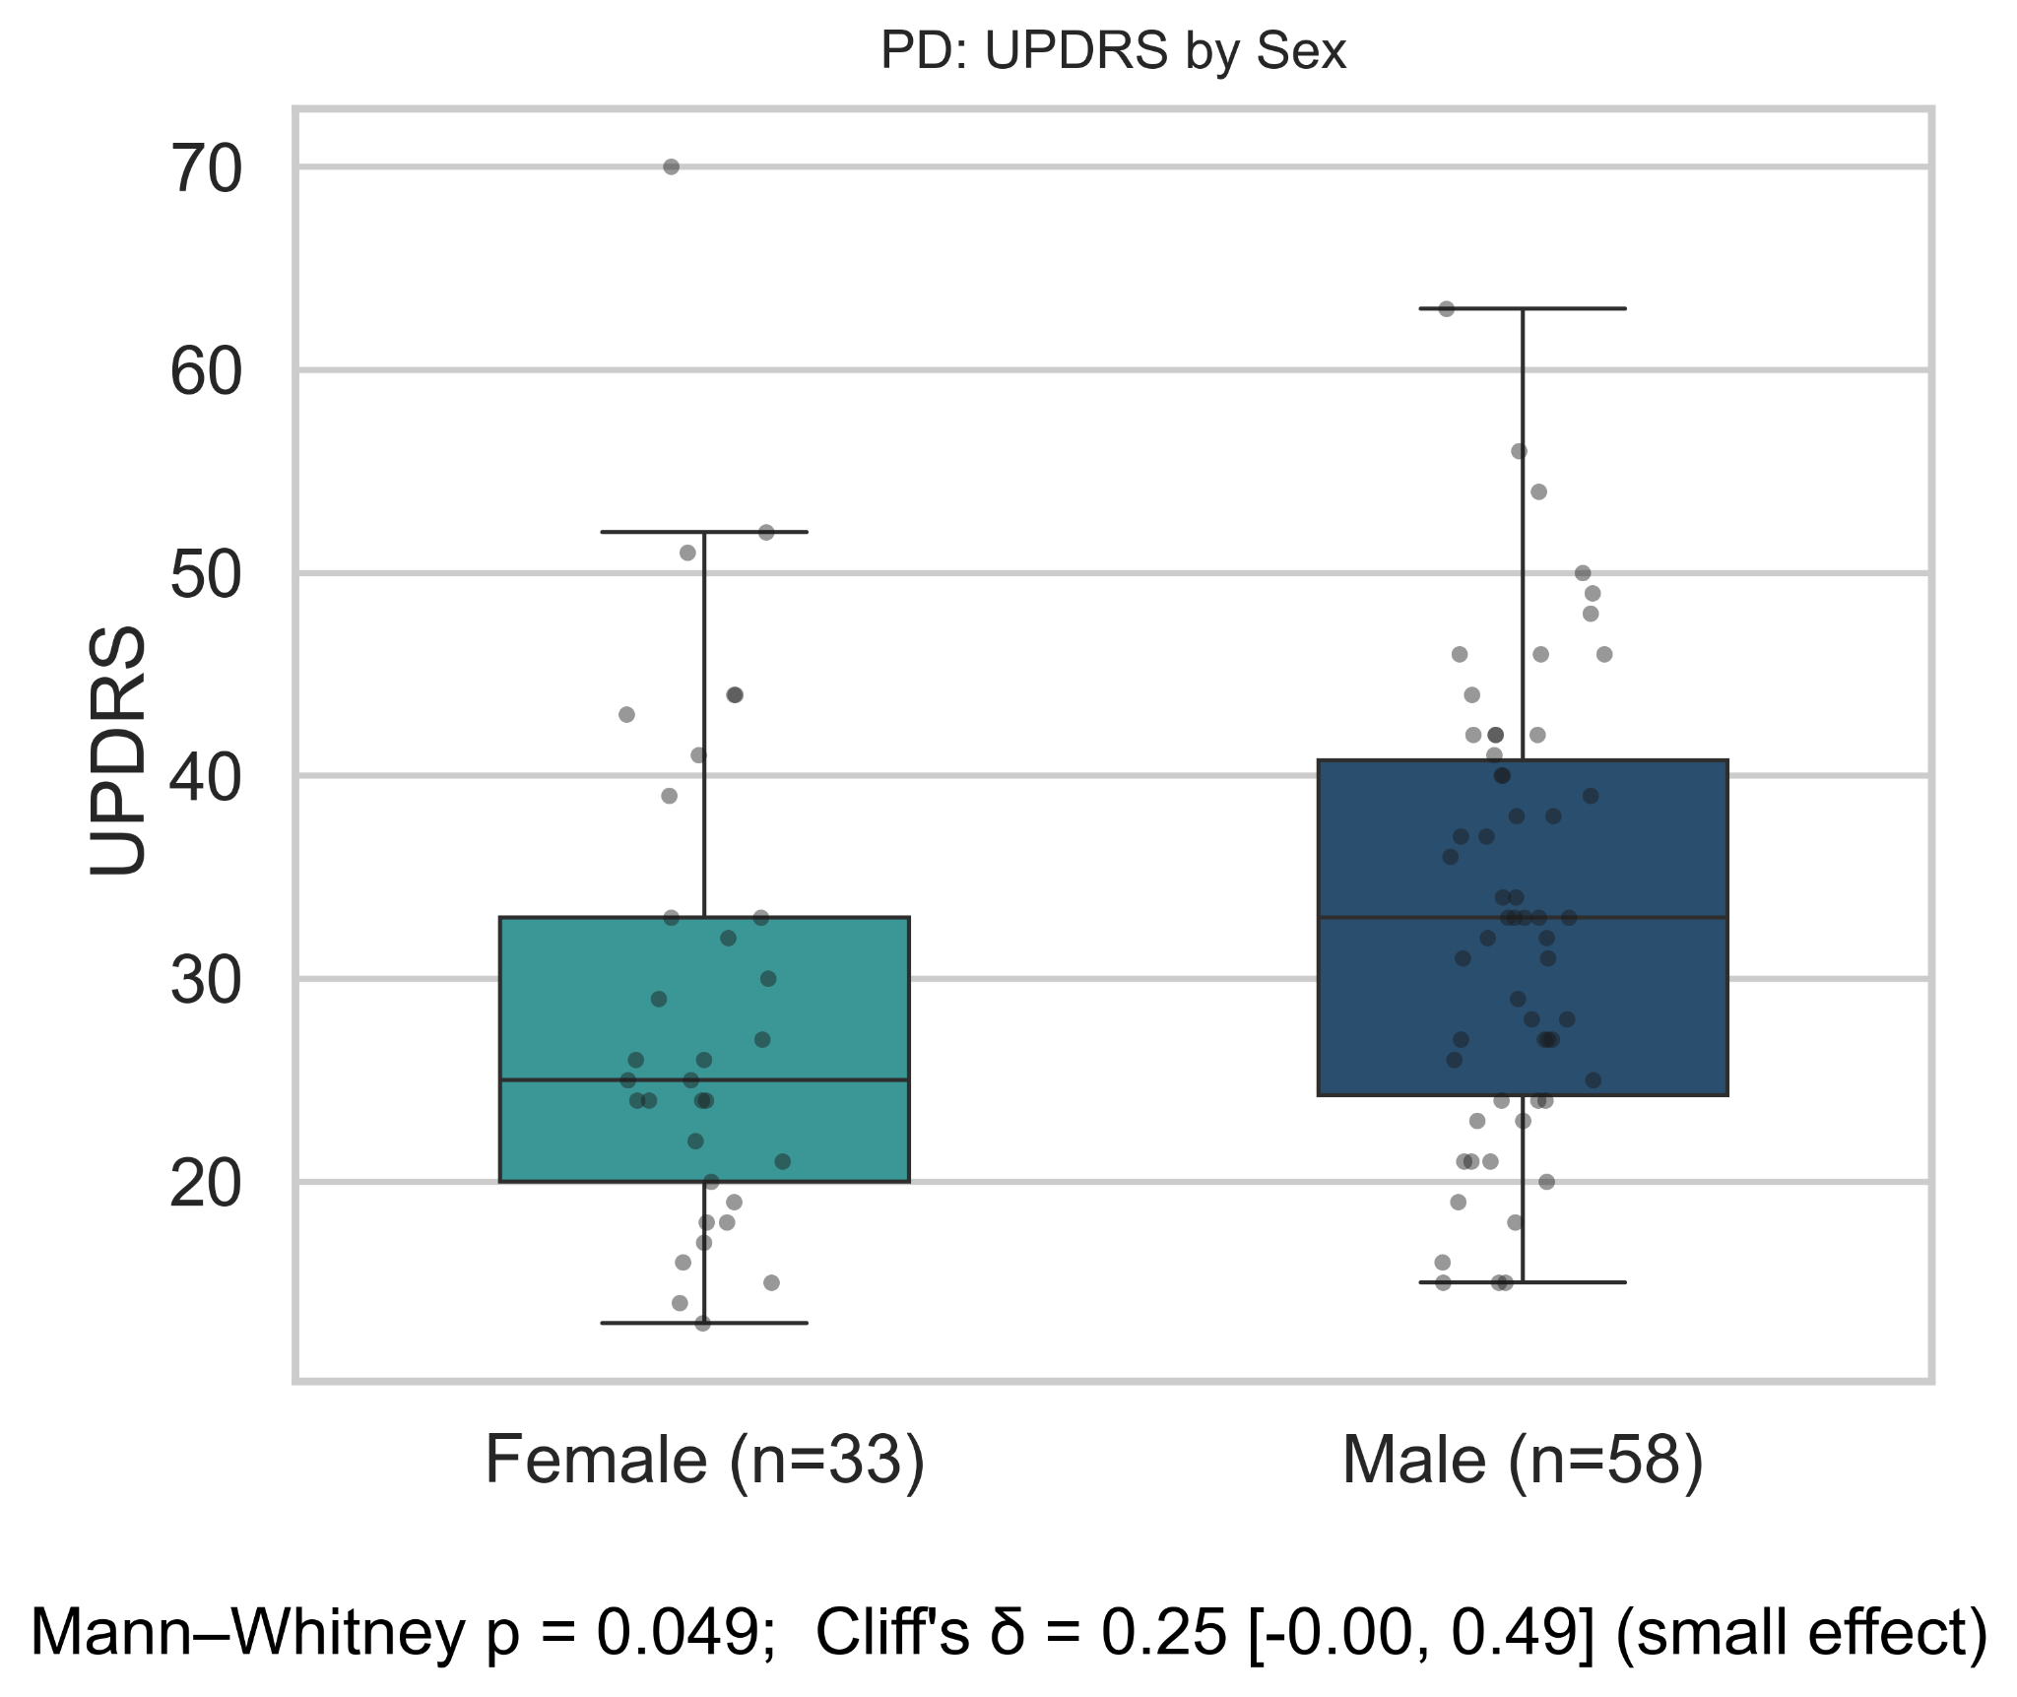
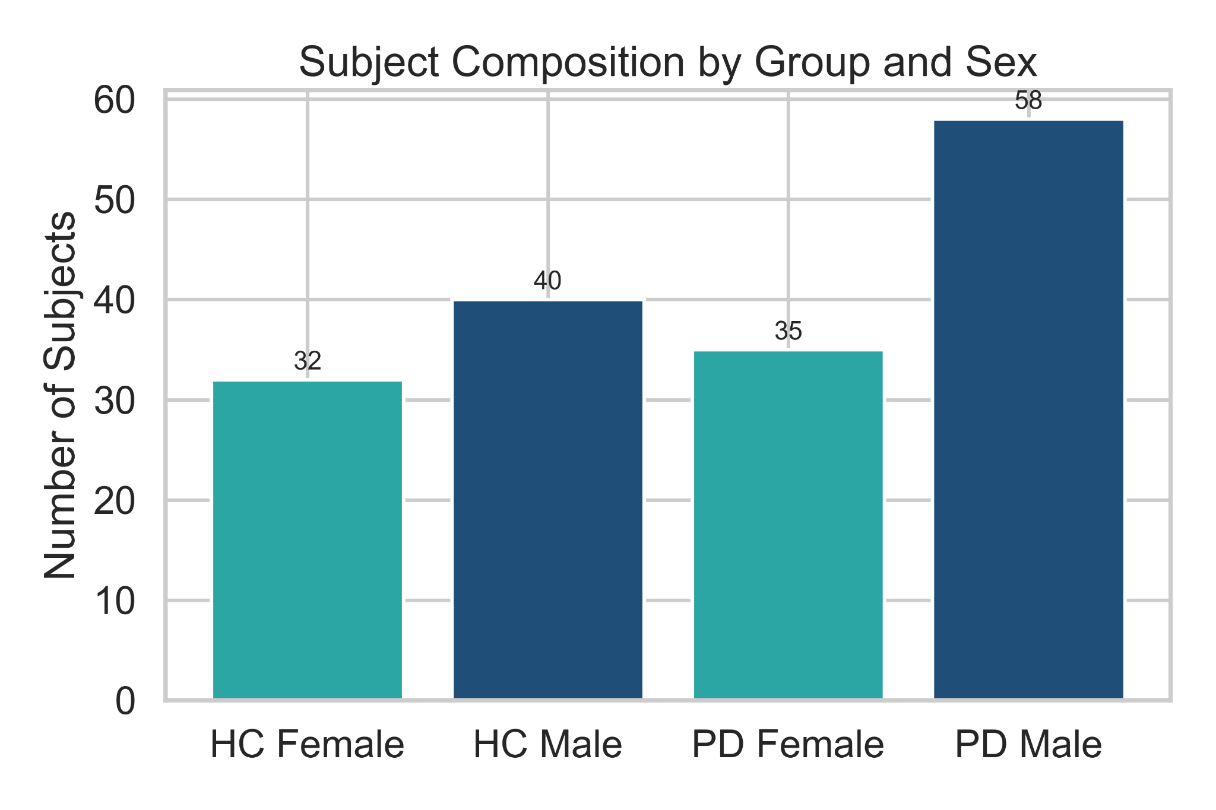
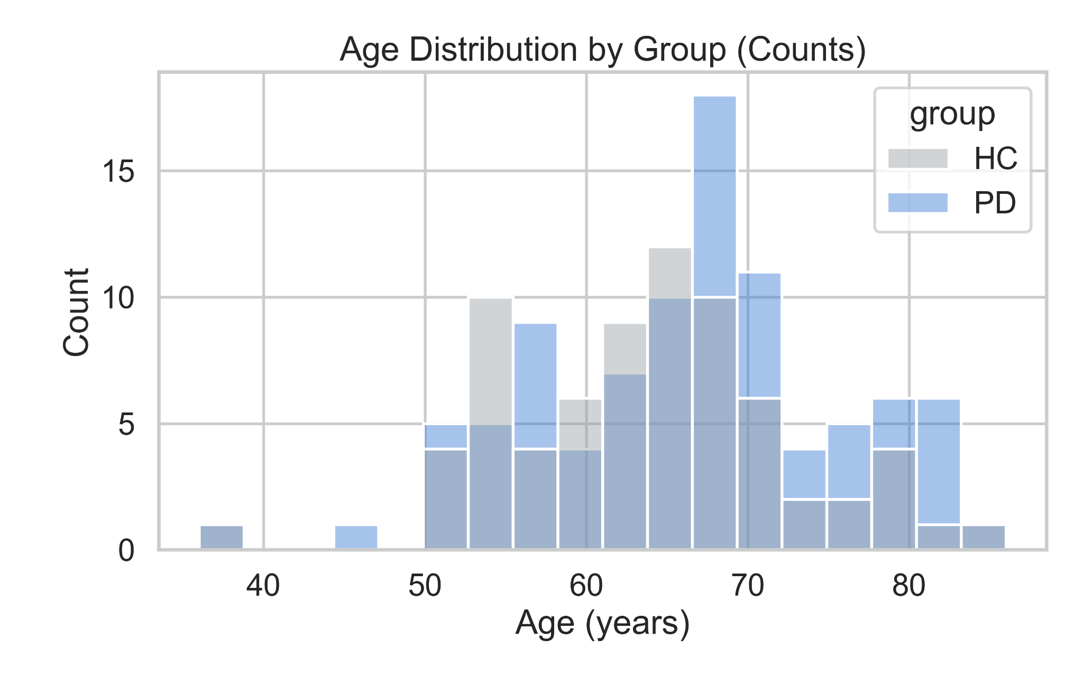
Dataset Overview: PhysioNet
Gait in Parkinson’s Disease Database (166 subjects — 93 PD, 73 healthy controls)
Balanced dataset with slightly higher representation of male PD participants.
PD and HC groups are closely age-matched, minimizing demographic confounds.
Male PD patients show slightly higher UPDRS scores and greater variability than females (p = 0.049; Cliff’s δ = 0.25, small effect), indicating marginally stronger motor impairment.

Slide 4
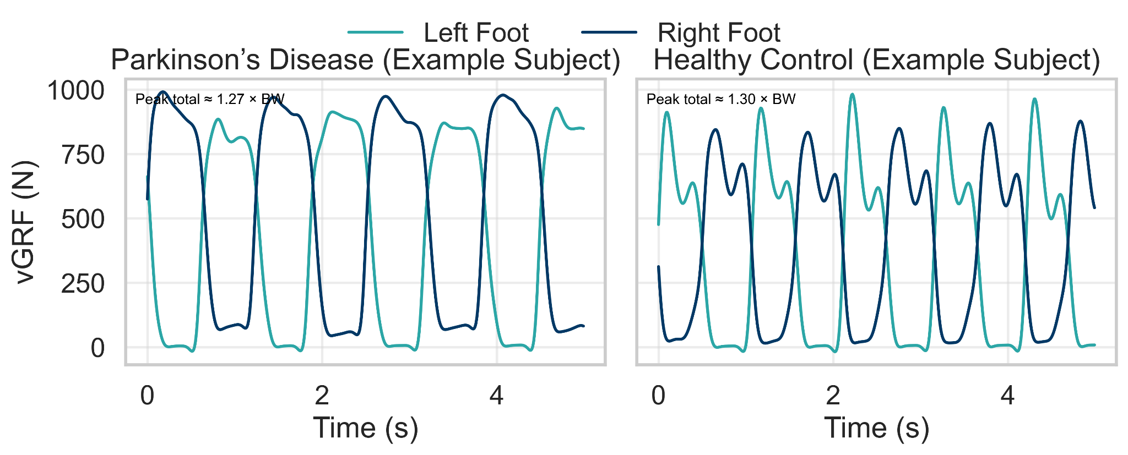
Example Vertical Ground Reaction Forces (vGRF) Cycles : Parkinson’s Disease vs Healthy Control
5-seconds segment sampled at 100 Hz (8 sensors per foot) - Usual walking (walk 01)
BW stands for Body Weight
Parkinson’s Disease (SiPt29, UPDRS = 70, 72 y, 0.86 m/s): Lower peak vGRF (near 1.27 × BW) and greater inter-limb asymmetry indicate reduced push-off force and impaired stance control, typical of bradykinetic gait.
Healthy Control (JuCo17, 65 y, 1.54 m/s): Balanced, rhythmic vGRF cycles with peaks near 1.30 × BW reflect stable gait rhythm and efficient weight transfer between limbs.
Observation: PD subject shows less consistent inter-limb timing and lower load transfer efficiency than HC, consistent with postural instability and reduced propulsion.
Technische Fakultät

Slide 5
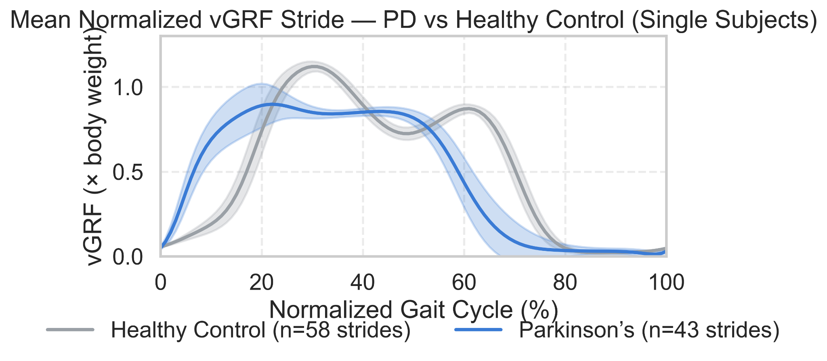
Mean Normalized vGRF Stride Comparison: Parkinson’s Disease vs Healthy Control
Normalized across 0–100% gait cycle, right foot (SiPt29 vs JuCo17)
PD subject (SiPt29) shows lower and flatter vGRF throughout the stride → reduced loading and propulsion.
Healthy Control (JuCo17) retains the two-peak pattern (heel strike + push-off) → rhythmic, symmetric gait.
PD displays merged peaks and greater variability (20–80 %) → unstable stance control.
Overall: PD gait = less amplitude, less symmetry, less efficiency.
Mean ± 1 SD across detected cycles per subject.
n denotes the number of detected gait cycles per subject used to compute the mean ± 1 SD curves.

Slide 6
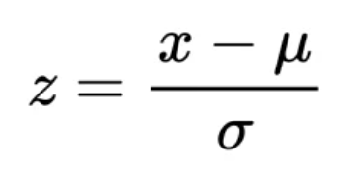
Feature Extraction and PCA Preparation Pipeline
Transforming raw vGRF signals into normalized, subject-level feature representations suitable for dimensionality-reduction analysis.
Preprocessing and Feature Extraction Steps
Process Summary:
Input: Raw vGRF (8 sensors/foot) sampled at 100 Hz
⬇
Segmentation: Sliding windows (300 ms window | 150 ms step)
⬇
Feature Extraction: TSFresh (e.g., autocorrelation, energy, entropy, RMS)
⬇
Aggregation: Mean | Standard Deviation | Skewness | Kurtosis. Aggregated per subject × foot → subject vector
⬇
Normalization & Dim-Reduction: Z-score → PCA visualization
Step | Description | Key Parameters / Notes
1. Signal Composition | Summed 8 load-cell forces per foot → total vertical GRF (vGRF). | Units: Newtons (N)
2. Windowing | Sliding windows across each signal to capture local gait dynamics. | 300 ms window, 150 ms step
3. Feature Extraction (TSFresh) | Extracted 60 + time-series descriptors (e.g., autocorrelation, energy, entropy, RMS). | Applied separately for Left and Right foot signals
4. Statistical Aggregation | Computed mean, standard deviation, skewness, kurtosis across windows per subject × foot. | Produces one feature vector per subject × foot
5. Normalization | Z-score normalization applied column-wise to remove scaling bias before PCA.
6. Feature Set Variants | Built three matrices for visualization: | • Left Foot only • Right Foot only • Combined (L + R concatenated)

Slide 7
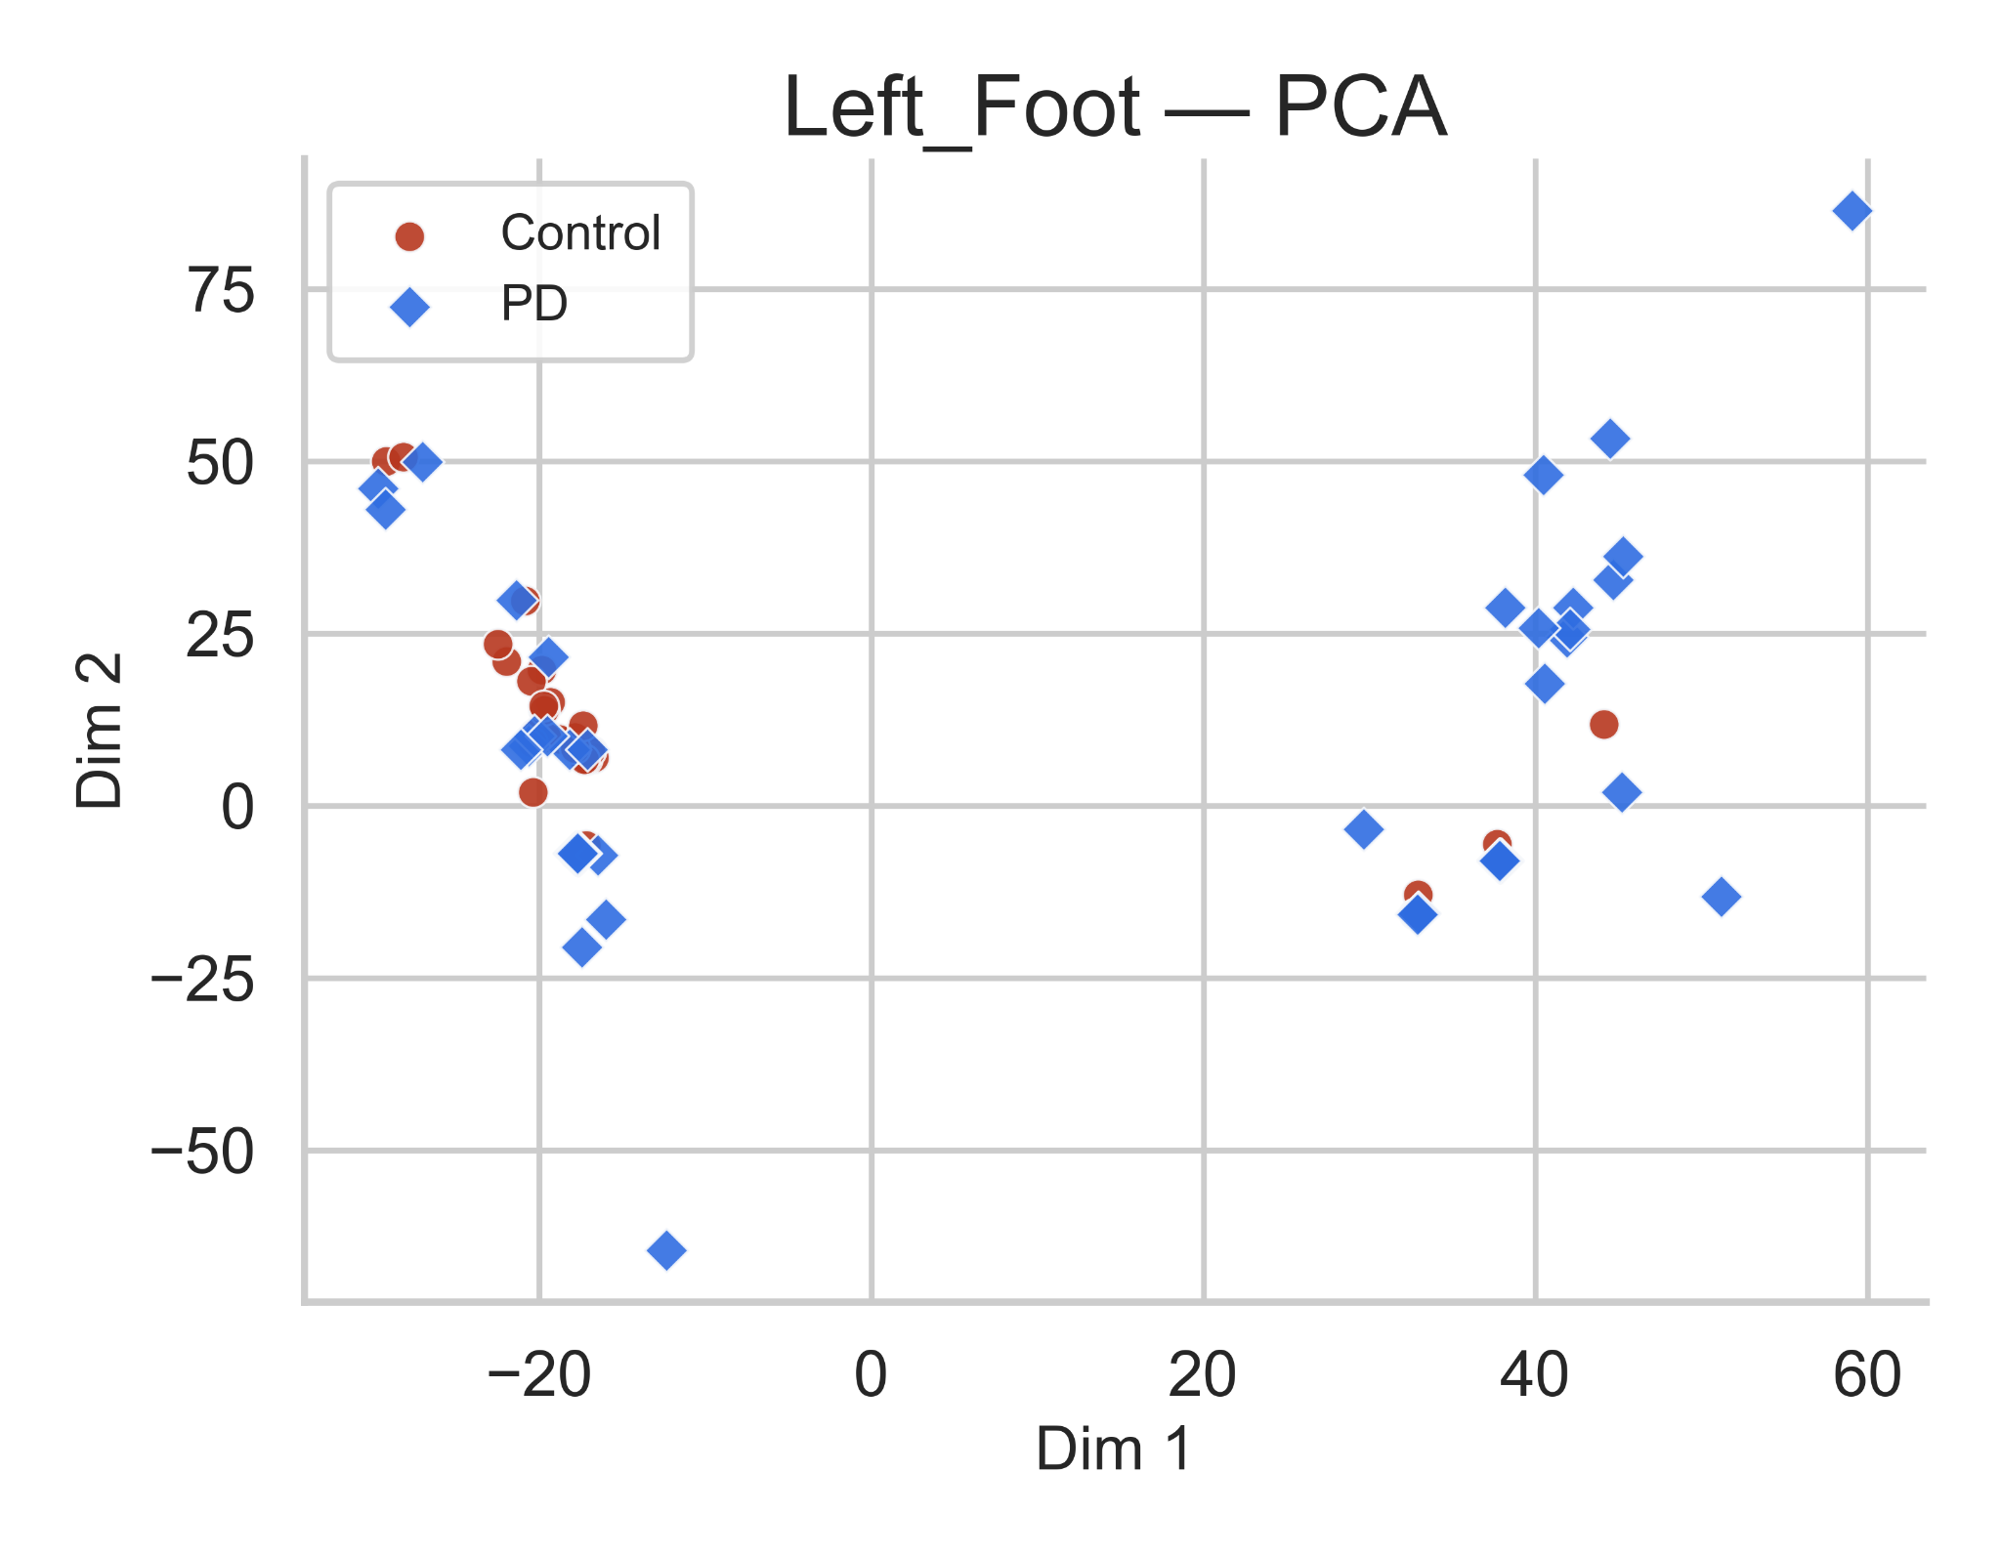
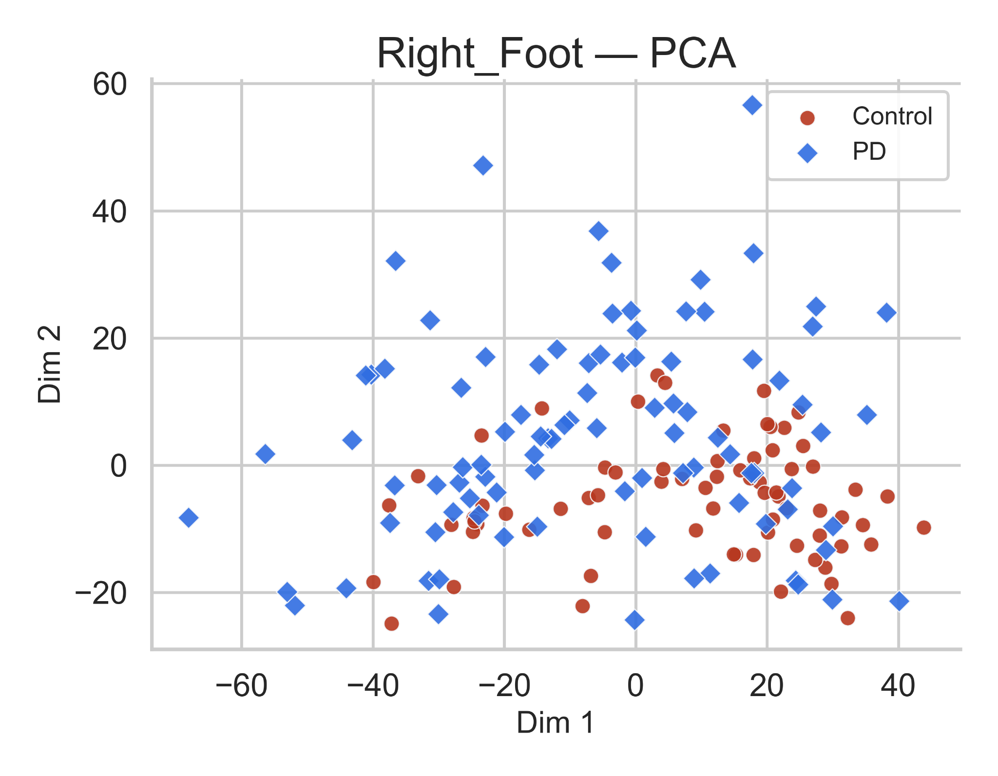
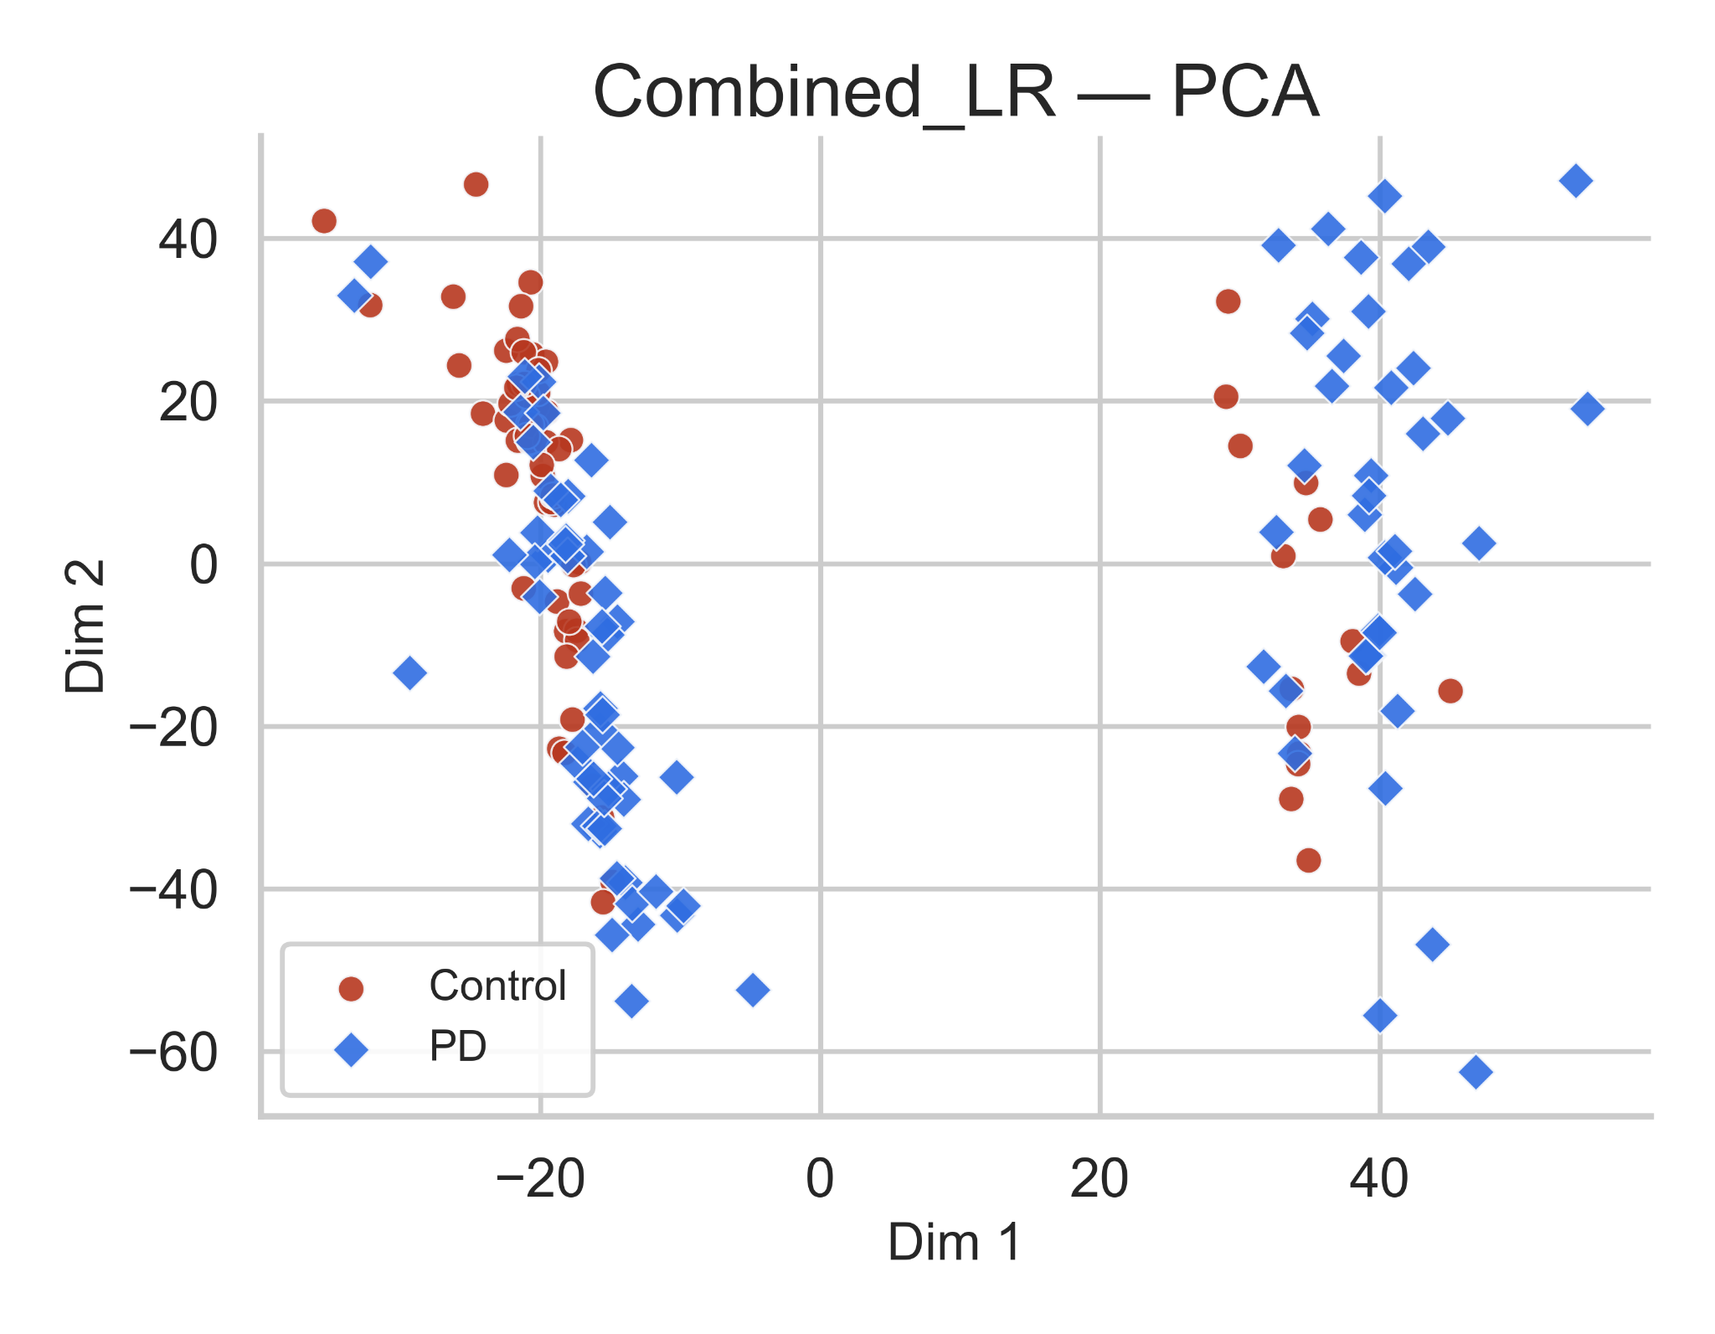
PCA Visualization of Extracted Gait Features
Evaluating how well TSFresh-derived gait features differentiate Parkinson’s Disease (PD) from Healthy Controls (HC) based on vGRF signals.
PD subjects are more spread out than controls → showing higher variability and less stable force control.
This could be linked to differences in how the affected side supports weight.
Here, both groups overlap quite a bit.
The right-foot features don’t show a clear difference, maybe because some PD participants use this side to compensate while walking.
When both feet are combined, the groups separate more clearly → capturing left–right coordination differences and overall gait asymmetry.
Takeaway: Left shows variability, right shows compensation, and combining both sides best highlights Parkinsonian gait asymmetry.

